Slide 1
STAFF ASSEMBLY GENERAL MONTHLY MEETING
July 12, 2022

Slide 2
How are you doing? Let us know using the annotate tool!
Optimistic
Frustrated
Grateful
Inspired
Tired
We will get started as a group at 12:05 PM
Well Rested!

Slide 3
STAFF ENGAGEMENT WORKING GROUP
Molly Bechtel
Jenna Blair
Stacey Brezing
Gisela Escalera
Shanna Fraites
Eva Guralnick
Mary Meyerzon
Babette Orendain
Tianna Sinnott

Slide 4
Staff Engagement Working Group
Charged in early 2022 with reviewing the 2021 Staff Engagement Survey results
Focused on three areas:
Career Development
Diversity and Inclusion
Retention
Evaluated survey data, interviewed campus partners and shared lived experiences
Identified recommendations
Notes:
Molly/Committee
Survey background: The University of California conducted the fifth systemwide Staff Engagement Survey between May 10 and June 4 of 2021. The survey was developed by the Council of University of California Staff Assemblies (CUCSA) in collaboration with Systemwide Human Resources’ Employee Relations department and Willis Towers Watson, a firm that conducts the survey on UC’s behalf. Roughly 20,000 randomly selected policy-covered staff, who joined the organization on or before June 1, 2019, received an invitation email to participate in the survey by Willis Towers Watson. The employee opinions gathered through the survey help to assess the level of involvement, commitment, and satisfaction staff feel toward their work. Conducting the survey every few years enables us to identify positive trends and opportunities for improvement. Prior Staff Engagement Surveys were conducted in 2019, 2017, 2015 and 2012.

Slide 5
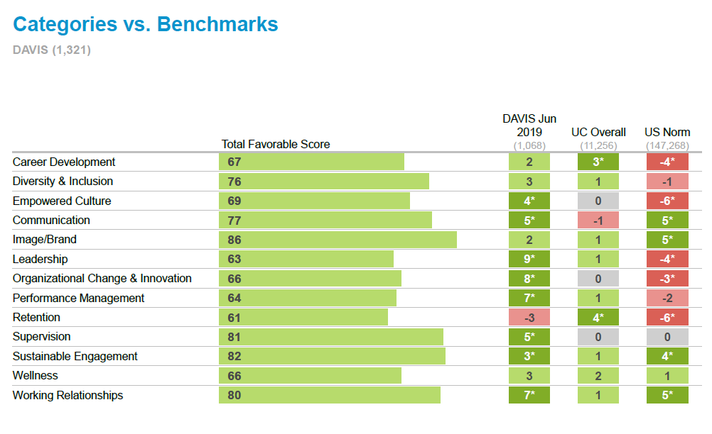
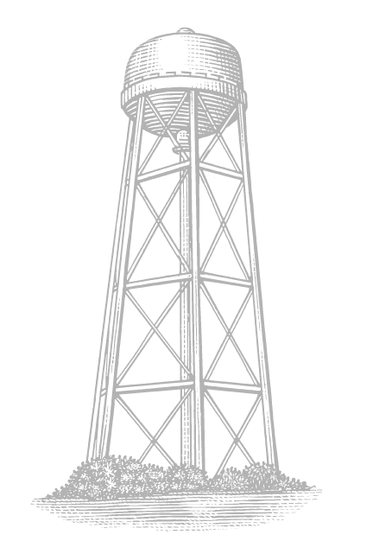
Notes:
Overview of how favorable score is calculated and what colors mean
The total favorable score is the percentage of respondents that marked Agree + Tend to Agree
Differences to norms are shown as % points. Norms may include past surveys, parent groups, industry, national or high performance benchmarks.
The darker colored boxes indicate statistical significance, where there are meaningful differences that we can be 95% confident did not occur by chance. The smaller the group size the bigger difference required for it to be significant
- Overall trends from 2019 to 2021 are strongly positive – all but one category improved by a statistically significant margin
- Retention (intent to stay or leave UC) was the only category to decline (-3 percentage points)
- More early tenure staff (3-5 years) are considering leaving UC
- While overall trends look strongly positive we can see opportunity areas when we look at the breakdown by Gender, Ethnicity, Role, and Tenure.
Across other categories covered in the survey, UC remains below the U.S. National norm but mostly above or on par with the University Staff norm
Note that the US Norm is all industries not just higher education
The US National Norm is comprised of a weighted average of employee survey results from a cross-section of industry sectors for operations located in the United States. The data is derived from recent client studies conducted by Willis Towers Watson. Data are weighted by size and by industry using current Census data so as to represent the distribution of employees in major industry sectors across the nation
# employees represented: 1,841,838
Example represented companies: AB InBev, Allegis, AT&T, BMW Group, Cardinal Health, Inc., CDW, Chevron, Discover Financial, Honda North America, KPMG, Kroger, L3 Technologies, Merck, Novo Nordisk, Penske Corporation, Providence St. Joseph Health, Sutter Health, TD Ameritrade, ThyssenKrupp, Wawa Inc., Wells Fargo, Whirlpool

Slide 6
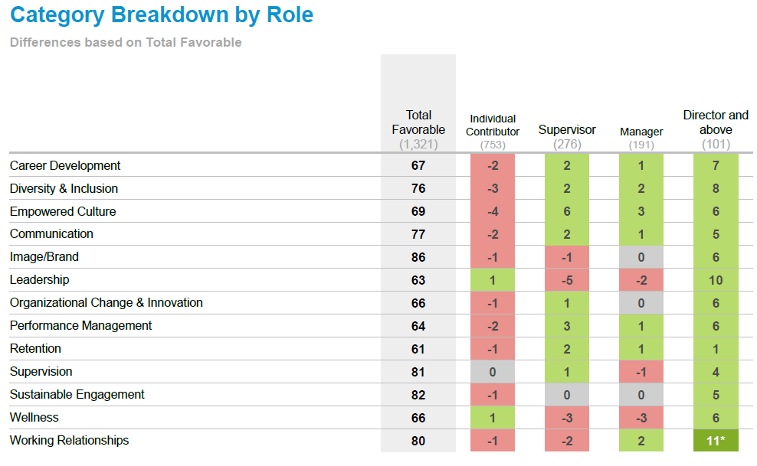
Notes:
We wanted to give everyone the opportunity to see the category breakdowns by different groups

Slide 7
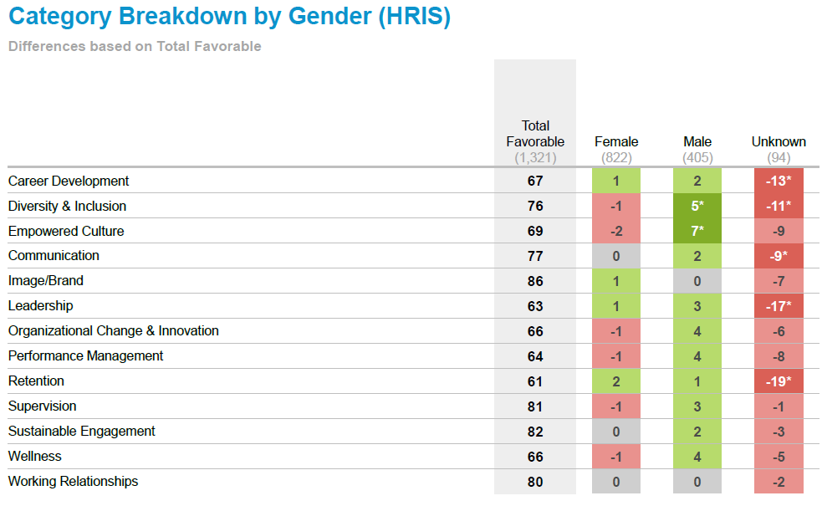

Slide 8
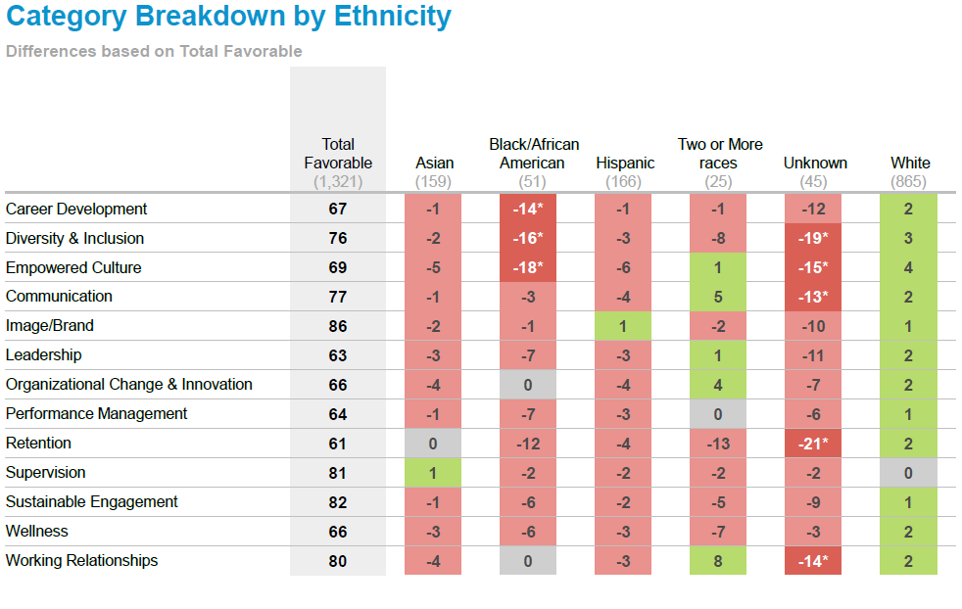

Slide 9
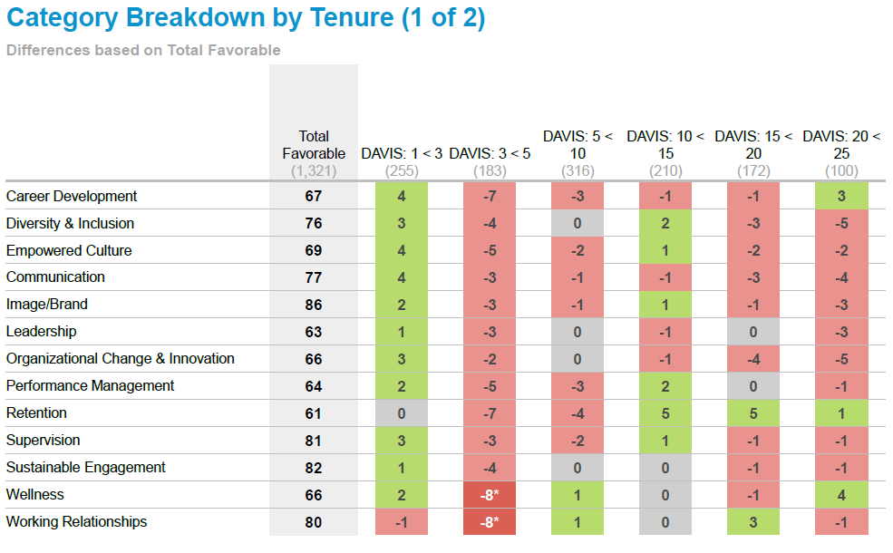
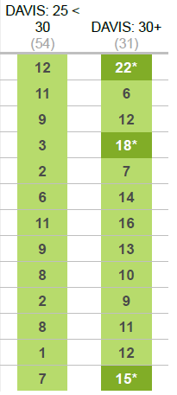

Slide 10
2022 Staff Experience Survey
Opportunities to improve:
Career: “I have good career opportunities.”
One of the strongest drivers of “Intent to Stay”
Equal Opportunity: “Regardless of background, everyone at UC Davis has an equal opportunity to succeed.”
Pronounced when looking across race
Notes:
Molly/Committee
Career and Equal Opportunity have potential for “very high impact on engagement”
Perception of Equal Opportunity is even more pronounced when looking across race, as well as other critical DE&I items - Black/African American Females are at risk of attrition

Slide 11
Interviews
Lyndon Huling, Manager, Leadership Recruitment & Diversity Services (HR)
Alejandra Martinez, Diversity & Outreach Coordinator, LRDS also joined discussion
Kelly Crabtree, Training Director, Learning and Development (HR)
Mikael Villalobos, Interim Associate Vice Chancellor & Associate Chief Diversity Officer, Office of Campus Community Relations (ODEI)
Ebony Lewis, Director of DEI Special Projects, Institute for Diversity, Equity, and Advancement (ODEI)
Robbie Tesnado, Chief Administrative Officer, Office for Diversity, Equity and Inclusion also joined discussion
Notes:
Molly/Committee
Goal of interviews: to secure some info about current efforts in the areas (and at the intersection) of diversity/inclusion, retention and career development

Slide 12
Recommendations Diversity & Inclusion
Require implicit bias training for RAC members
Clarify/train on DEI in annual performance appraisal process
Promote a culture of DEI with meaningful recognition of completed trainings related to DEI
Recommend the establishment of department-level DEI groups
Establish mechanism to support active involvement among AACs and Constituent Groups in Staff Assembly
Act on findings of Aggie Black Listening Sessions
Notes:
Molly/Committee

Slide 13
Recommendations Career Development
Publicize release time policy with bi-annual reminders
Annual letter of support from leadership to participate in campus service
Develop, promote and recognize programs for staff advancement and retention (e.g., UC Davis Health Cross Training, Facilities Management Future Leaders Program)
Notes:
Molly/Committee

Slide 14
Recommendations Retention
Expand exit surveys to inter-campus position changes, publicize results to key stakeholders and develop policies and action items to address identified issues
Continue to increase transparency around topics such as equity adjustments and salary scales by developing clear information and making it easily accessible on the HR website
Require initial training for new supervisors and ongoing training for all supervisors on university HR policies and best practices
Notes:
Molly/Committee
Recognize and promote awareness that retention strategies not only create a healthier work environment for all staff but are a valuable cost-saving strategy

Slide 15
Staff Engagement Working Group
Thank you to all members!
Jenna Blair
Stacey Brezing
Gisela Escalera
Shanna Fraites
Eva Guralnick
Mary Meyerzon
Babette Orendain
Tianna Sinnott
Questions?
Notes:
Molly/Committee
Survey background: The University of California conducted the fifth systemwide Staff Engagement Survey between May 10 and June 4 of 2021. The survey was developed by the Council of University of California Staff Assemblies (CUCSA) in collaboration with Systemwide Human Resources’ Employee Relations department and Willis Towers Watson, a firm that conducts the survey on UC’s behalf. Roughly 20,000 randomly selected policy-covered staff, who joined the organization on or before June 1, 2019, received an invitation email to participate in the survey by Willis Towers Watson. The employee opinions gathered through the survey help to assess the level of involvement, commitment, and satisfaction staff feel toward their work. Conducting the survey every few years enables us to identify positive trends and opportunities for improvement. Prior Staff Engagement Surveys were conducted in 2019, 2017, 2015 and 2012.

Slide 16
HUMAN RESOURCES “MYTH BUSTERS” SESSION 2
Mark Chatman Talent Acquisition Manager
Lyndon Hulling Manager, Leadership Recruitment & Diversity Services
Aaron Locquiao Benefits Manager
Jim Hankins Executive Director, Shared Services Organization (SSO)
Steve Chilcott Executive Director, Workforce Strategies
Maria Lucia Gonzalez Compensation Manager
Brian Linhardt Compensation Manager
Steve Green Executive Director, Employee Labor Relations (ELR)

Slide 17
Talent Acquisition
Does a staff member have to inform their manager that they are applying/interviewing for another position at UCD?
Signing Bonuses – Real or not?
Notes:
Mark or Lyndon

Slide 18
Talent Acquisition
When will HR require employment verification? Is it required now?
Is it an HR policy that there must be more than one viable candidate to move forward in an interview/hiring process?
Notes:
Mark or Lyndon

Slide 19
Compensation/Talent Acquisition
Is it true that hiring authorities cannot negotiate higher than the first quartile for wage negotiations?
Is it true that a degree of any kind, even if not related to the position, outweighs years of experience?
Notes:
Mark or Lyndon or Maria

Slide 20
Compensation/Talent Acquisition
Is it true that someone working in a position for 10 years could be making the same as someone who is hired into that position today, even if the other person has more institutional knowledge?
Can a department offer an applicant (or an employee) a lower salary because they wish to work remotely some/all of the time?
Notes:
Mark or Lyndon or Maria

Slide 21
Compensation & Classification
Truth or myth? Represented staff do not get merit increases for performance on top of their union-contract increases.
Is there a policy that positions can only be on contract for up to five years? And are there "consequences" for a position remaining on contract for over five years?
Notes:
Maria or Brian

Slide 22
Compensation & Classification
In an Exempt title, is it true that, when a co-worker is out on extended leave, I am ineligible for a temporary stipend to recognize the extra work I do if their pay classification is at or below my pay classification?
Is there a recommended number of direct reports for a supervisor to have? Is there a maximum number?
Notes:
Maria or Brian

Slide 23
STAR Awards
Myth or truth: A STAR award cannot be issued for more than $500?
Is it HR policy that a staff person cannot receive a STAR award unless they perform a one-time extraordinary duty that would be outside their position description? Even with a faculty letter supporting the nomination?
The form states: Exceptional performance: Demonstrated and sustained exceptional performance that consistently exceeds goals and work expectations in quantity and/or quality.
Notes:
Maria or Brian

Slide 24
STAR Awards
Is it really policy that represented staff in most bargaining units cannot receive STAR awards? It doesn't appear to be explicitly prohibited in contracts. If it is prohibited, why is it in the interests of either the university or the unions to prevent recognizing exceptional work through a program like STAR awards?
Notes:
Maria or Brian

Slide 25
Benefits
When you resign from the university, do you have to actually work your last day, except for when you are retiring?
What happens to a staff member's sick and vacation hours when they separate from the University?
When you leave the UC system you get paid out for your un-used vacation hours - what pay rate are those hours paid at?
Notes:
Aaron

Slide 26
Equity Increases
Is it true that if you leave the university before age 50, you do not retire from the university, or can you leave at one date but officially retire later?
I am not sure if I can get retiree health benefits if I have earned them by having enough service credit but I am not yet 50 years of age when I reach 20 years of service.
Notes:
Aaron

Slide 27
Personnel Files
Are employees able to make an appointment to review their HR Files?
Yes. To make an appointment to review HR files, employees can send an email request to AggieService@ucdavis.edu or directly to Christin Espinoza at cmespinoza@ucdavis.edu
Notes:
Jim

Slide 28
Performance Appraisals
Staff in their first year in a role cannot receive an “exceeds expectations” rating on their performance evaluation.
Is it an HR policy that only one staff member in a unit can receive "exceeds expectations" rating on their performance evaluation?
Is it true that Supervisors are required to “bell curve” grade" their staff for performance evaluations, even when the whole team has performed exceptionally?
Notes:
Steve C.
*Asked 4 times* - other wordings included below
Is it acceptable for your supervisor to give you a lower score on your performance review because they've been told by leadership they have to "bell curve" numbers to save money when it comes time for giving out yearly salary merit adjustments? For example, say someone was told verbally they've been doing "exceeds expectations" work all year, but they need to officially get "met expectations" because "leadership doesn't want us to give out good scores to everyone." I've been told by my HR rep that "this is not policy, but its practice--and therefore it is acceptable."
Is it true that Supervisors are required to "grade" their staff on a bell curve for performance evaluations, even when the whole team has performed exceptionally?
I've been told that managers/supervisors meet to level ratings for their staff because they cannot give too many exceptional or exceeds expectations ratings. Is it true that some ratings are reduced to ensure there aren't too many high ratings even when an employee deserves that rating?

Slide 29
Personnel
Is it an HR policy that two members of the same family cannot work for the same department?
Is it true that HR does not require exit interviews?
Is it true that if development officers are not succeeding in a current role that they won't be allowed to transition to a different role on campus?
Notes:
Steve C.

Slide 30
Labor
Are union employees allowed to opt out of lunch voluntarily?
Are union employees not allowed to work on site without a supervisor present?
Is it true that preferential re-hire is only for the same position/classification that an employee was last employed? Does policy still exist?
Notes:
Steve G.

Slide 31
Sick and Vacation Time
You cannot take vacation the first 6 months with the university. Truth or myth?
Is it a policy that the expectation is to have less than 12.5 days of sick call outs a year? If so where do we have such policy?
You have to provide a doctor's note if you are out sick for more than 3 days
Notes:
Steve G.

Slide 32
Sick and Vacation Time
Exempt (salary) staff don’t need to utilize a vacation/wellness day on their time sheet as long as they work a minimum of 4 hours.
Can exempt staff work a 4 days/10 hours a week schedule?
Can staff remain on regular pay status (and not have to use vacation) when searching, applying and interviewing for a position at UCD?
Notes:
Steve G.

Slide 33
Flexible Work
Is it HR policy that everyone is expected to work the same amount of days in-person during the summer as we do during the academic year?
Is it an HR policy that management must live in California?
Is it campus practice that if a staff member temporarily works remotely (family member becomes ill and they have to provide care), that they have to forward their work phones to their personal devices?
Notes:
Steve G.

Slide 34
Flexible Work
A colleague is the caregiver of their severely disabled in-law who lives in their home. Being able to work remotely has meant that they are present for their relative, who needs someone in the house but does not need intensive care that would interfere with work. Colleague is being told they must return to work in the office full-time even though they don't need to be in the office to do their job, because UC doesn't count in-laws for caregiving purposes. Is that true?
Notes:
Steve G.

Slide 35
Questions for Other Offices
Follow up with SISS:
Is it UC policy to render visa assistance for candidates for academic, but not staff positions?
Follow up with ICC/Student Affairs:
Student assistants are not allowed to work more than 49%.
Notes:
Staff Assembly will follow up with SISS and ICC about these two questions because they fall more into their areas of expertise.

