Slide 1
Government and Community Relations

Slide 2
Government and Community Relations Team
(Alpha by last)
Mabel Salon Chief Government and Community Relations Officer
Isabel Zepeda Corona Analyst and Fiscal Officer
Jared Giarrusso-Khlok Manager, GCR Health
Tammy Heath Executive Analyst
Loraine Hernandez-Covello Manager, Advocacy Relations and Communications
Sumiko Hong Director, Community Engagement Aggie Square
Adrian Lopez Senior Director, Government Relations
Brandon Minto Director, Federal Government Relations
Mary Mumper Administrative Officer, Aggie Square
Laura Niznik Williams Director, GCR Health

Slide 3
Authority
REGENTS STANDING ORDER
The President shall represent the Corporation and the University in all matters requiring action by the Congress or officers of the United States, the Legislature or officers of the State of California.
OFFICE OF THE PRESIDENT
UC Governmental Relations (state and federal) is an office within the UC External Relations and Communications division
Ultimately, UC GR reports to the UC President
Local Governmental Relations is not centralized at UCOP

Slide 4
Government role in the output of our mission
We serve to advance understanding and support for UC's tripartite mission of teaching, research and public service
UC's principal representative to state and federal elected officials and agencies
UC Governmental Relations represents university positions on legislative, budgetary and policy matters
Each campus has a government and community relations team
UC Davis Government Relations and Community Relations team includes Health

Slide 5
Why is Government and Community Relations important?
Important to have a seat at the table
Convey UC impact at local, state and federal levels
Garner support to advance enterprise initiatives
Good Town Gown relations
Legislation/regulations impact operations
Budget – Money/resources to expand research, capital outlay, deferred maintenance, etc.

Slide 6
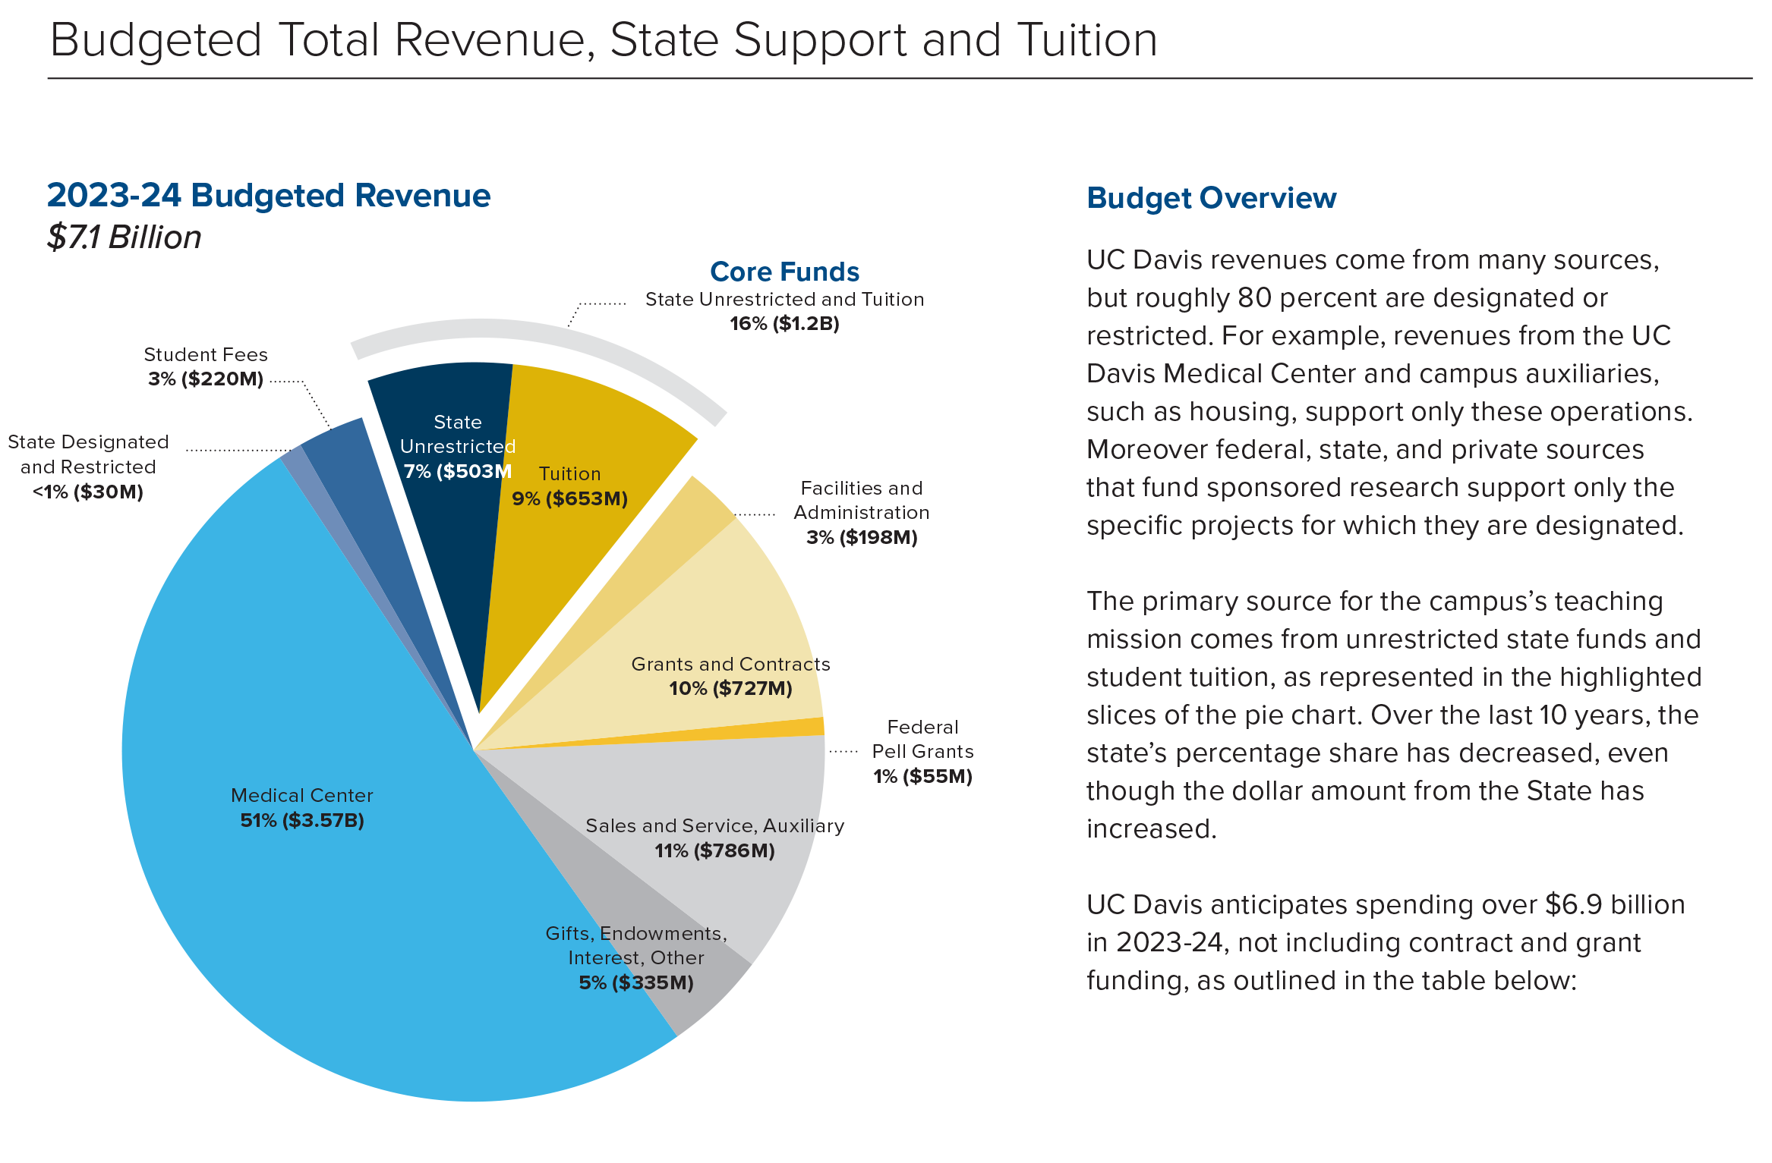
Budget in perspective
527,401,229 Federal Research
Comprises 52% Enterprise Research Funding

Slide 7
Advocacy for UC Davis
UC President
UC State & Federal Governmental Relations
UC Davis
Support to Chancellor May, leadership, staff, faculty and students
Daily local relations with community leaders and regional organizations, garnering local support
Ongoing relations with legislative/congressional members in our district and neighboring area
Campus briefings and tours
UC Day, Sacramento and DC visits
UC Advocacy Network

Slide 8
UC Davis and UC Davis Health Relations
COMMUNITY Work with local communities on issues affecting quality of life, i.e., economic development to diversity, and leadership
LOCAL Work with cities, counties and school districts and build partnerships between local governmental organizations and the campus
STATE Campus liaison to state and tribal governments, work with the Legislature, the Governor’s Office, state agencies
FEDERAL Campus liaison to the federal government, work with Congress, the Administration, and federal agencies

Slide 9
Local Government and Community Relations
Long Range Development Planning
Hate Free Together
Aggie Square
Government Relations
Community and neighbor relations
Workforce efforts
Youth opportunities
Community Benefit Agreements

Slide 10
State Government Relations
State Budget
The Compact
Legislation
Sponsored Legislation
Testimony to inform policy making

Slide 11
Top Federal and State Legislative Issues
College Access / Affordability
Immigration / DACA / Border Security
Housing
Food Security
Health Care
Climate Water
Wildfires
Infrastructure
Gun Control
Criminal Justice Reform
Other Issues
HEA Reauthorization
Research Funding

Slide 12
Federal Government Relations
Engagement in DC and at home
Federal Budget (Appropriations, Community Project Funding, Shutdowns)
Legislation
Expert Testimony
Casework (Issues with the Federal Government)

Slide 13
Health Government and Community Relations
Health policy and advocacy
Local
State
Federal
Community Relations
Liaison between the health system and community/neighbors
Community board service and interaction with Community Based Organizations
Manage UC Davis Health Community Advisory Board

Slide 14
What role can staff play in Advocacy? Stay informed
Understand UC advocacy and political engagement activities policies
There are potential criminal and civil penalties for misuse of public resources, and, in the case of the rules that apply to tax-exempt organizations, the university’s tax-exempt status could even be jeopardized.

Slide 15
What role can staff play in Advocacy? Stay informed
Consult with Government and Community Relations
Annual guidance from UCOP
Restrictions on the Use of University Facilities and Resources (Political Activity Policy),
Legal Guidelines for UC Participation in Ballot Campaigns,
Policy on Use of University Properties
310-50, Communications with Government Officials
guidance on topics like invitations to and from government officials, correspondence, representing the university

Slide 16
What role can staff play in Advocacy? Stay informed
Not on State time or with State resources or in your capacity as staff/faculty
Can’t endorse a candidate in capacity as staff/faculty - but can as an individual and can use title for identification purposes only but need to have a disclaimer
Can’t take positions on bills or propositions--University as a whole can take positions on bills, not campuses or faculty/staff
As an individual and on your own time, can partake in political activities including running for office or work campaigns

Slide 17
What role can staff play in Advocacy? Stay informed
Engagement
Advocate vs Expert?
Can testify as an expert witness, talk about research, educating the committee
Can meet with members of the legislature to talk about work/research

Slide 18
What role can staff play in Advocacy? Join UCAN
UC Advocacy Network (UCAN)
Led by
UCOP State & Federal Governmental Relations
A digital advocacy platform (email/social media and texts) for staff/students/faculty/friends of UC
Runs UC and UC Health state and federal advocacy campaigns
3,411 UCD affiliated advocates out of 50K total
Opt-in only, share with your networks
https://www.universityofcalifornia.edu/get-involved/advocate

Slide 19
What role can staff play in Advocacy? Enter your programs!
https://communityimpact.ucdavis.edu/
The UC Davis Public Engagement Database centrally houses information
UC Davis and the UCOP use this data to quantify our public reach and impact
UC Annual Accountability Report and UC in Your District Maps for state and federal, also local requests
Relies on UC Davis community to enter/populate
List of Guiding Questions to help determine types to enter
Anyone in the UC Davis community can enter program information directly into the database

Slide 20
Government and Community Relations
Questions?
Contact us, website: https://gcr.ucdavis.edu/
Tag us: @UCDavisGCR

