Slide 1
Disability Services
Benefits, Leaves, Worklife
Elizabeth Hammond Delo, Exec. Director

Slide 2
Disability Services
DMShelp@ucdavis.edu

Slide 3
Disability Services
Overview
Who we help
What is a disability
What is the interactive process
What are reasonable accommodations
Supervisor/Manager Tips
Employee Tips
Accessibility Tips

Slide 4
Disability Services
We help employees and applicants with disabilities and their supervisors engage in the interactive process to find reasonable accommodations that allow them to perform their essential job functions
Our goal is to help people keep working!

Slide 5
Disability Services
We serve all employees and applicants with their own disabilities along with their supervisors/hiring managers at both campus and health
Staff, Faculty, Academic or Student employees
An employee who has a family member with a disability would work with their supervisor, Leaves, WorkLife, Employee & Labor Relations

Slide 6
Disability Services
A disability is a physical or mental impairment that limits one or more major life activity.
A life activity can be eating, walking, talking, sleeping, etc.
A disability can be visible or invisible
A disability can start in childhood or develop later in life
A disability does not mean incapacitated

Slide 7
Disability Services
Pregnancy
While many people do not consider pregnancy a disability, the law protects pregnancy like a disability
Pregnancy related accommodations can start prior to pregnancy and continue after giving birth

Slide 8
Disability Services
Americans with Disabilities Act (ADA)
Fair Employment and Housing Act (FEHA)
Family and Medical Leave (FMLA)
California Family Rights Act (CFRA)
Pregnancy Disability Leave (PDL)
Pregnant Workers Fairness Act (PWFA)
Workers' Compensation (WC)
UC Policy: Personnel Policies for Staff Members (PPSM) & Academic Personnel Manual (APM)
Collective Bargaining Agreements (CBA)

Slide 9
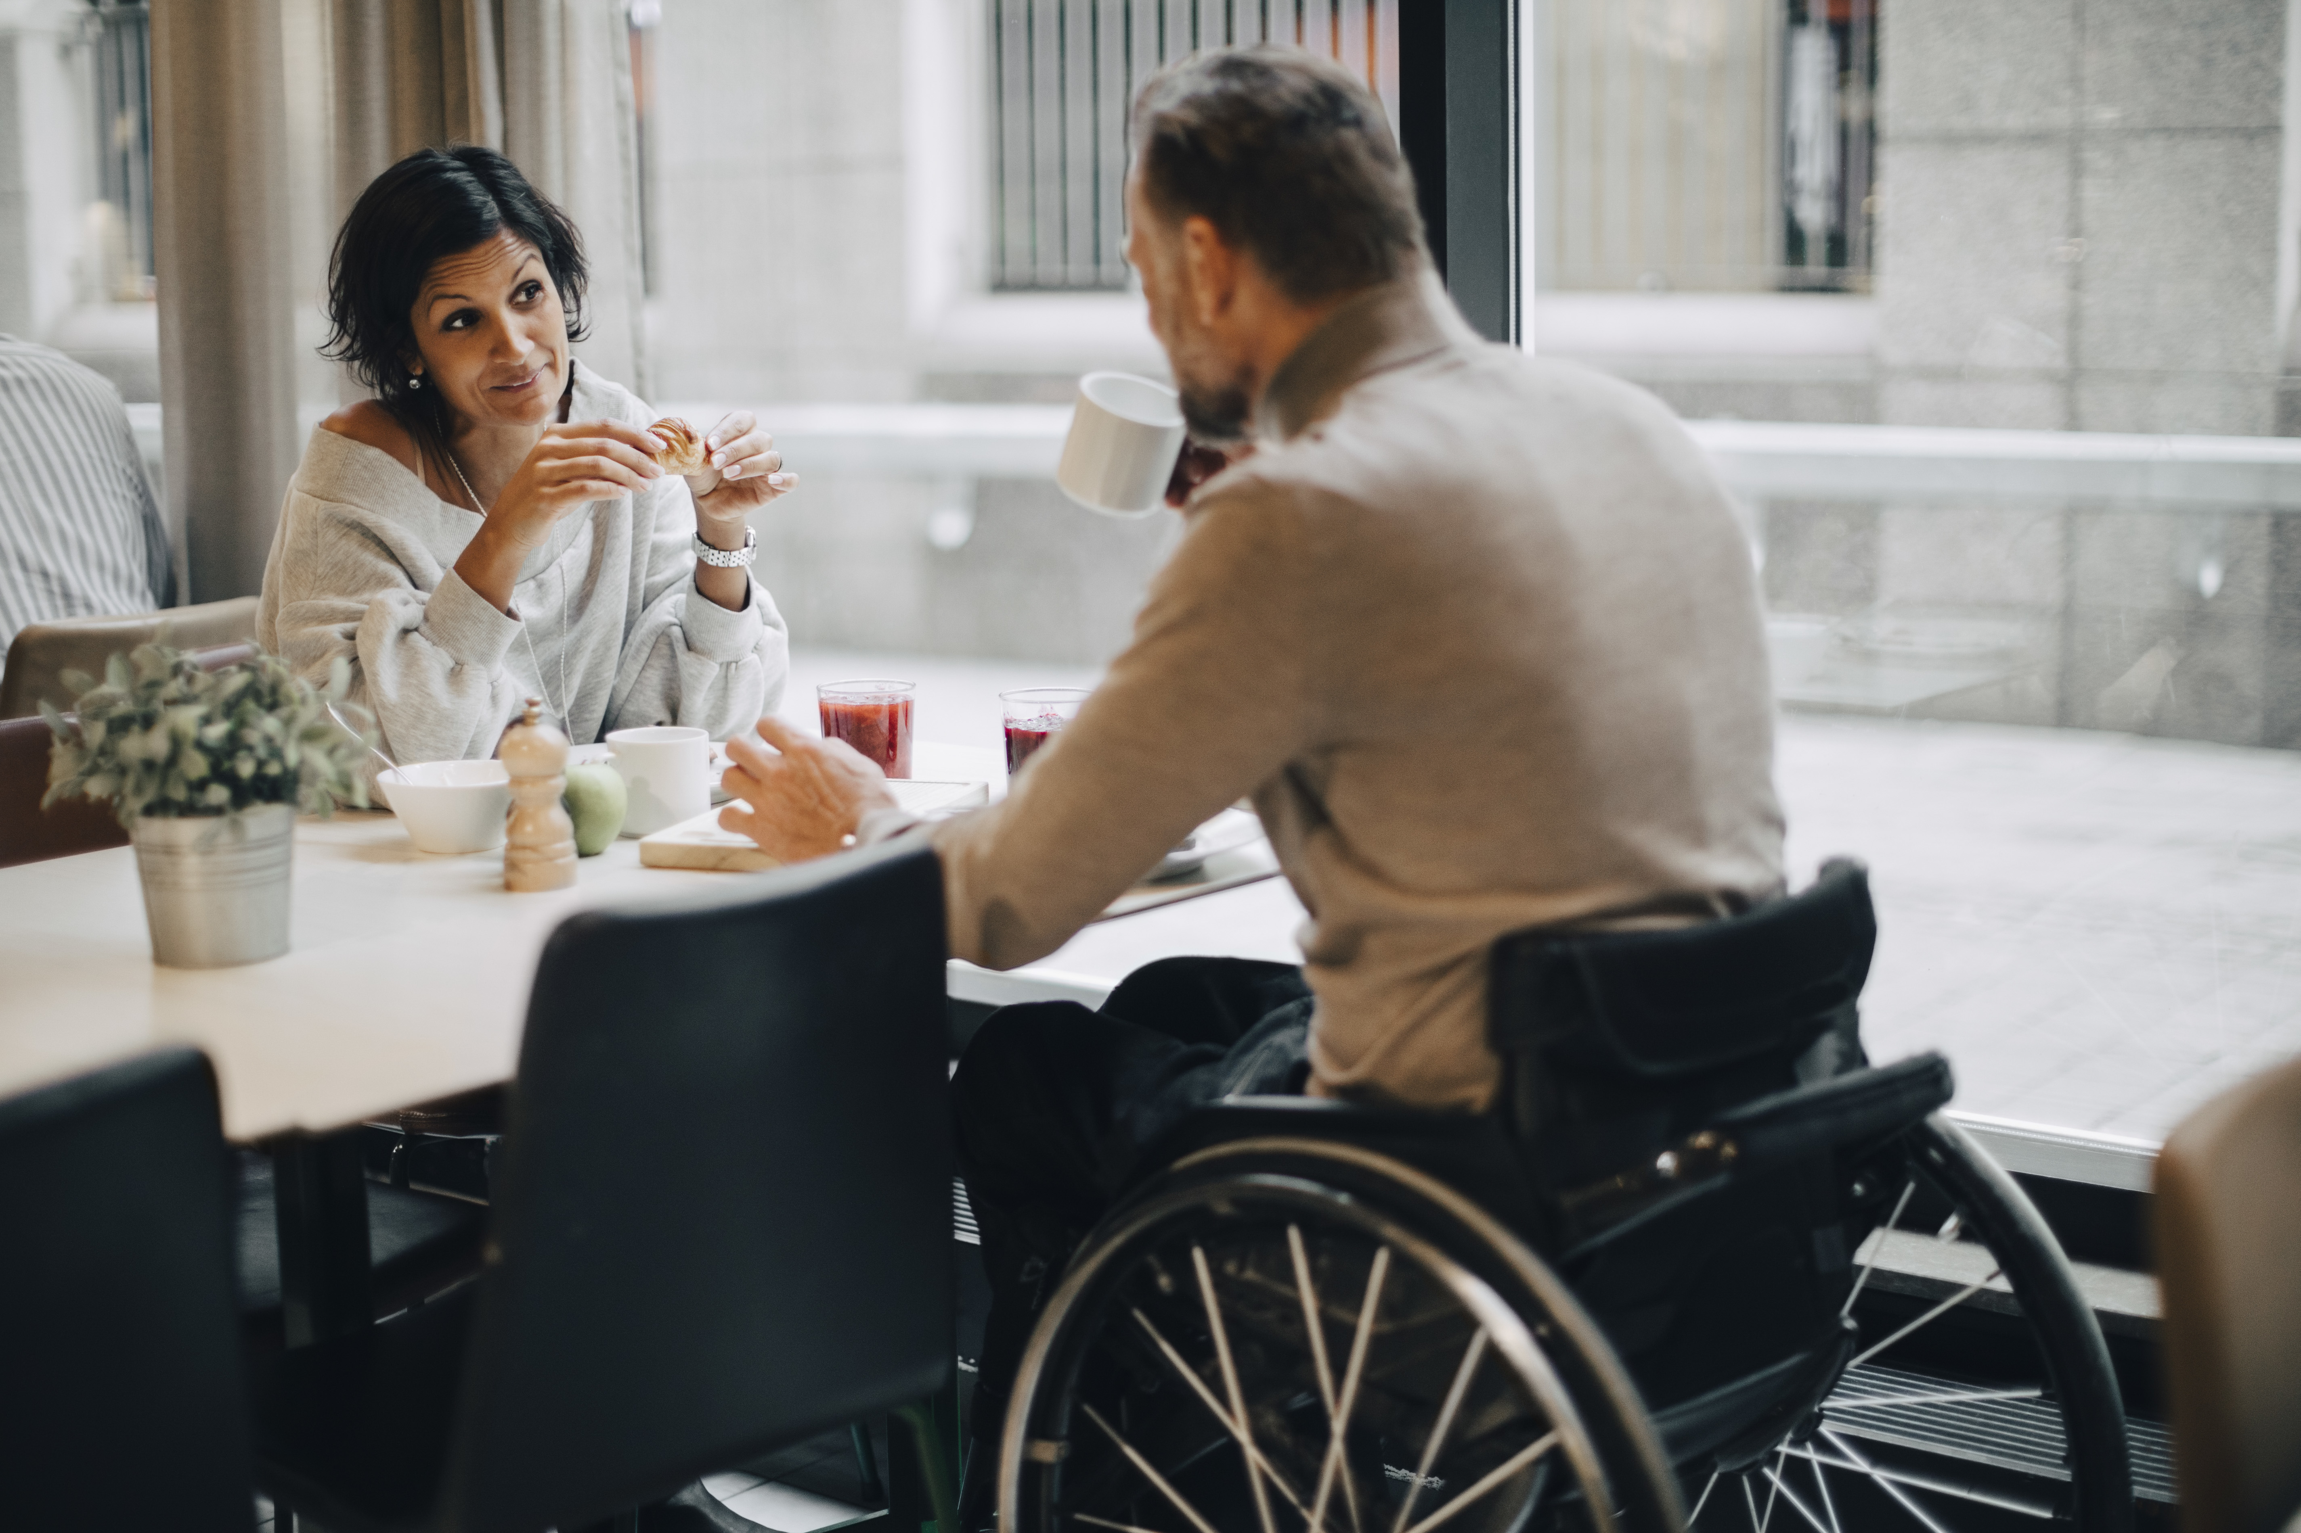
Disability Services
The interactive process is an ongoing discussion or dialogue between a supervisor and the employee with help from DMS about disability related restrictions/limitations, essential job duties and ideas for reasonable accommodation.

Slide 10
Disability Services
A reasonable accommodation is an adjustment that allows a person with a disability to perform the essential job functions and participate in all aspects of employment
Some examples:
Time off for medical appointments and treatment
Modification of work tools or provision of equipment
Modified work schedule
Leaves of absence
Assistive technology, devices or services
Modification of existing facilities

Slide 11
Disability Services
The employee's disability limitations/restrictions from their medical provider helps us understand how their condition may impact their work duties
If three employees have a degenerative disc condition with low back pain:
A custodian may have lifting/stooping/bending restrictions
A faculty member may have standing restrictions
A graduate advisor may have sitting restrictions

Slide 12
Disability Services
We ask that medical documentation be sent to DMS to protect an employee's privacy. We share limitations/restrictions but not diagnosis or other confidential info
An example of limitations/restrictions:
difficulty with concentration and focus, easily distracted by visual and auditory stimuli
An example of accommodation request:
remote work

Slide 13
Disability Services
Supervisor/Manager tips:
There are no magic words to request an accommodation
"I am having difficulty/trouble performing my ABC work duties because… I have a medical condition/disability/illness/injury and I need XYZ"
Don't automatically say no, we have an obligation to engage in the interactive process and provide accommodations, if possible
Do say:
How can I help?
I don’t know what is possible, let me reach out to DMS
More tips on DMS website: https://hr.ucdavis.edu/departments/elr/dms

Slide 14
Disability Services
Employee tips:
Discuss your request for accommodation with your supervisor
No need to share diagnosis or confidential details
We recommend following up with an email:
"As I mentioned I am having difficulty performing my job tasks ABC because of a medical condition and I would like to explore reasonable accommodations including XYZ. I have copied DMS to help"
More tips on DMS website: https://hr.ucdavis.edu/departments/elr/dms

Slide 15
Disability Services
A few accessibility tips
Include accessibility statements for events, interviews, onboarding, brochures, etc.
Make sure online content includes alt text for pictures, images
Use sans serif font like Arial at 11pt or higher
Caption all audio and use transcripts for video
Use clear, plain language and headings
More tips: https://hr.ucdavis.edu/departments/elr/dms and
https://accessibility.ucdavis.edu/

Slide 16
Benefits
Benefits@ucdavis.edu

Slide 17
Benefits
NEW! UCPath automatic reinstatement of disability coverage
Employees on leave for their own serious health condition are entitled to a waiver of disability premiums (voluntary short term and long term)
UCPath is automating reinstatement of coverage after an employee returns from leave for their own serious health condition
We recommend employees double check coverage and premiums are reinstated 2 months after returning (disability premiums paid in arrears)

Slide 18
Benefits
NEW! Experian Identity Theft Protection for all benefit- eligible employees and retirees eff. 4/1/24
This benefit is paid by UC; you need to take action to start monitoring:
Credit monitoring, reports and scores
Identity theft insurance and restoration
Dark web monitoring
Device protection and online privacy
Digital financial management tools
See UCnet for more information and to sign up for webinars
https://ucnet.universityofcalifornia.edu/news/2024/03/uc-introduces-employer-paid-identity-theft-protection-for-faculty-staff-and-retirees.html

Slide 19
Benefits
NEW! Retirement Support
UC Davis Retirement Help desks March 5th- May 7th: hr.ucdavis.edu/employees/benefits
Retirement Administration Service Center (RASC) now offers 1:1 retirement counseling appointments: rasc.universityofcalifornia.edu
Schedule a meeting with a UC-dedicated Fidelity Workplace Financial Consultant: myucretirement.com/Counseling
RASC Retirement Planning webinars and recorded presentations
Schedule of Financial Education Classes hosted by Fidelity
UC Davis weekly help desks Wednesdays 10-11am Benefits Help Desks

Slide 20
Campus Leave Team
AggieService

Slide 21
Campus Leave Team
Coming soon for campus and health
Revised Pregnancy Leave Workshop
NEW! Pregnancy Leave Workshop for nurses
NEW! Parental Leave Workshop (available on demand)
In process
Managers and Supervisors: What you need to know about leaves
https://hr.ucdavis.edu/departments/shared-services

Slide 22
WorkLife
Worklife@ucdavis.edu

Slide 23
WorkLife
Lactation Support Program
Individual consults, support groups, newsletters and classes. Includes return to work support.
Just added 8 more lactation rooms!
Child Development Centers
Four centers total
Room available at Bright Path in Sacramento
Coming soon! Transitional Kindergarten program
Take our Children to Work Day April 25, 2024

Slide 24
Questions?

